Slide 1



AceNgage
Dec’22 Performance Awards
AceNgage
Feb’23
Performance Awards

Slide 2

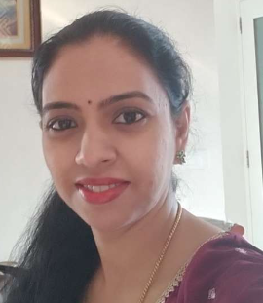


ACE PERFORMER
Three months in a row Chaya Ramesh has knocked the performance targets out of the park ! No number is too big or too small for this dynamic woman!
A star performer with immense focus and determination to be the best – Chaya has achieved these numbers every month keeping her quality and controllable targets too in mind .
She delivers tangible results every month and AceNgage is truly proud to have her as a part of the Exits team. Keep Shining!
CHAYA RAMESH
Digital Certificate and
Gift voucher

Slide 3
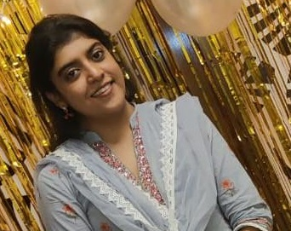
QUALITY PERFORMER
One of the first members of the ELITE TEAM , Fathima has consistently out performed month on month!
Her Quality and Productivity scores continue to be the best. We are extremely proud of you and truly appreciate all the effort you put in to be the best.
The commitment she brings to the table is something not to doubt at all. She has a long way to go. Shine on Always!
Well deserved!
Quality – 84%
FATHIMA JABEEN
Digital Certificate and
Gift voucher

Slide 4
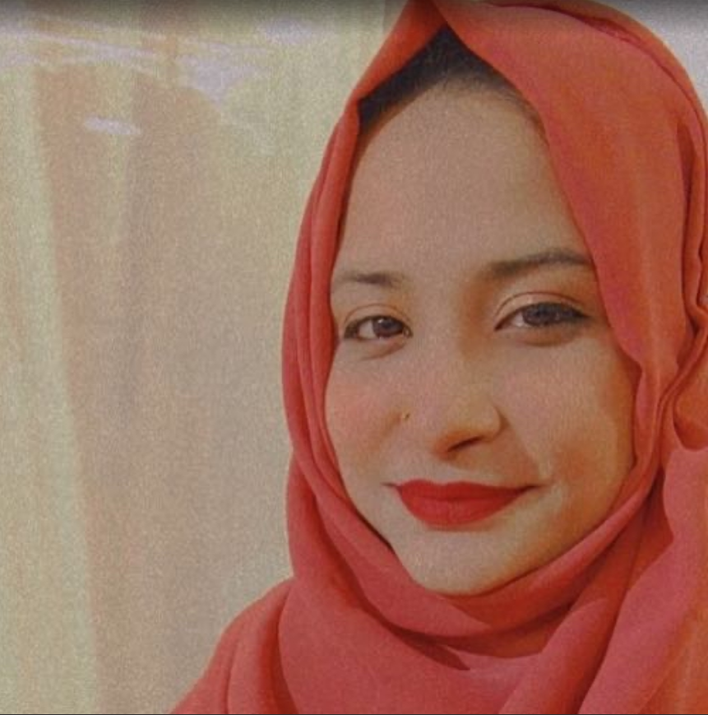
QUALITY PERFORMER
Her positive attitude, attention to detail, and ability to go above and beyond expectations has made a significant impact on our team. Her contributions have helped us achieve our goals.
A consistent performer when it comes to her quality scores , Sama’s hard work and commitment to the job has truly made a difference.
Thank you for all that you do, and we look forward to seeing your continued success in the future.
Keep being the awesome Team Player that you are! Keep Shining!
Quality – 80%
SAMA NAQVI
Digital Certificate and
Gift voucher

Slide 5
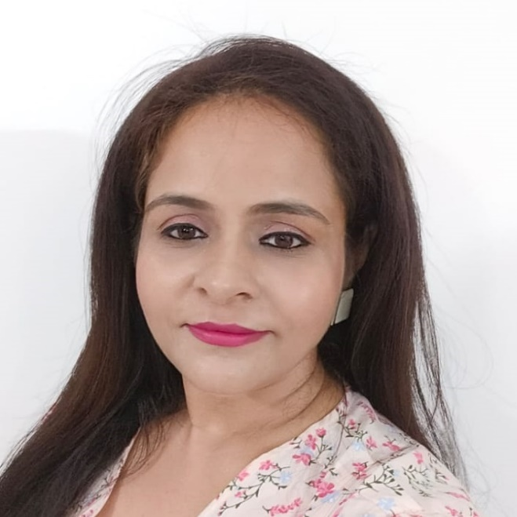
QUALITY PERFORMER
Your hard work and high performance in such a short span of time in NHE has truly been impressive!
We are delighted to have a diligent employee like you in the team. We thoroughly appreciate your effort and skills. All the best and continue to shine on!!
Keep being the awesome Team Player that you are! Keep Shining!
Quality – 80%
PUNIT CHANDOK
Digital Certificate and
Gift voucher

Slide 6
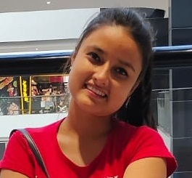
MOST IMPROVED PERFORMER
Her persistence and determination in completing your numbers helped us reach our targets much more quickly.
Your brilliant problem-solving skills helped us to reach our targets. It is wonderful to see you consistently work hard to deliver the best results. Absolutely proud of your efforts !
Thank you for an excellent job last month!
Good Job!
ANISHA REGMI
Digital Certificate and
Gift voucher

Slide 7
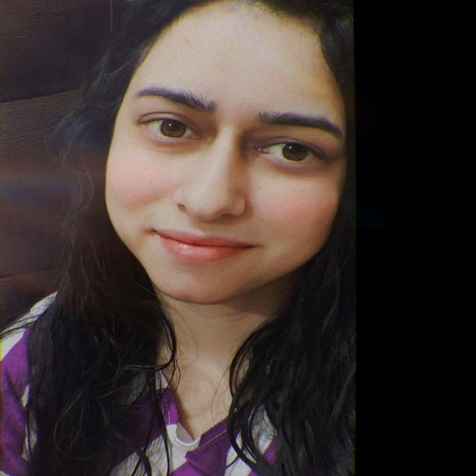
MOST IMPROVED PERFORMER
We truly appreciate your work! You put a lot of effort into what you do, and it shows in your performance at the end of the month – you have managed to overachieve your Adherence, Quality and Controllable targets.
Thank you so much for your dedicated performance. The ownership that you deliver is next level. Continue to keep shining at what you do!
Keep up the spirit, Well Done and all the best for many more successes!
Good Job!
NAVNEET KAUR
Digital Certificate and
Gift voucher

Slide 8
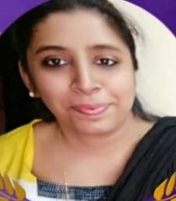
MOST IMPROVED PERFORMER
Really proud to see your efforts to improve overall quality month on month and getting 79% quality, 61% Controllable, and adherence at 117% !!
Your target achievement is spot on! You have come a long way and we are proud to have you in our team. Kudos to your hardwork and cheers to many more successes!
Keep up the spirit, Well Done and all the best for many more successes!
Good Job!
TASKEEN AHMED
Digital Certificate and
Gift voucher

Slide 9
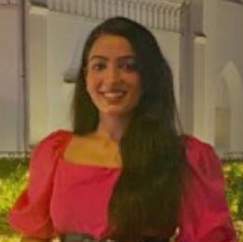
PAT ON THE BACK
You have been ON POINT with your performances right from the first month. Your positive approach, sincerity, and dedication towards work is clearly visible and no doubt you are consistently giving best performances month on month.
She is sharp, tenacious and a natural problem solver. We highly appreciate your hard work , commitment and dedication.
Thank you for your efforts !
Good Job indeed!
PRIYA NARANG
Digital Certificate and
Gift voucher

Slide 10
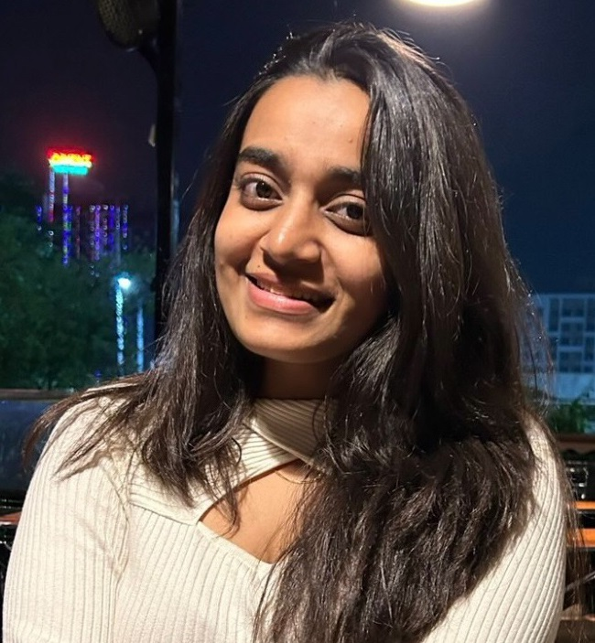
PAT ON THE BACK
She worked hard to land us good business, and her efforts bore fruit. We appreciate her focus and grit in going above and beyond, managing everything that comes her way, and helping the team meet the goals.
She is the best team member any SME can ask for!
Her attention to detail is an asset to the team. She is a wonderful co-worker and it’s a joy to have her in the team.
She definitely deserve a pat on the back!
SHRADDHA WAGHMARE
Digital Certificate and
Gift voucher

Slide 11
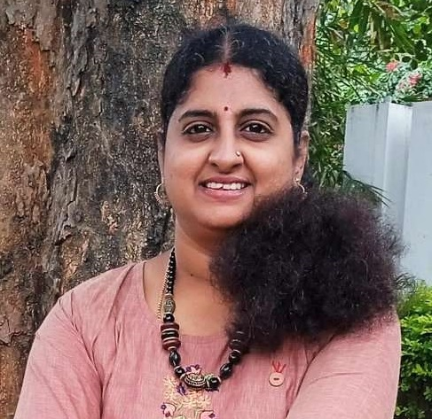
PAT ON THE BACK
Swati is the most dedicated counsellor you ever can come across. Thank you for being someone we can always count on.
We are so grateful for all of your hard work! The entire team thanks you for everything you do.
It's a rarity to come across people who are so dedicated and sincere and a big shout out to you for overachieving all your KRAs.
She definitely deserve a pat on the back!
SWATHI M G
Digital Certificate and
Gift voucher

Slide 12
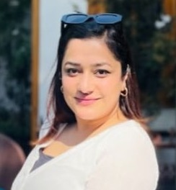
PAT ON THE BACK
A consistent performer who has proved her mettle in the organization with her discipline and hard work. She has helped us immensely by pitching in for a special PwC assignment at the last minute and completing it diligently with only few minutes of training!
She puts 100% efforts in whatever she does and makes sure that the quality is not compromised at any cost.
She is a true asset to AceNgage, and we are proud to have her! adherence: 210%; quality: 81%; controllable: 68%.
She definitely deserve a pat on the back!
RITIKA VERMA
Digital Certificate and
Gift voucher

Slide 13
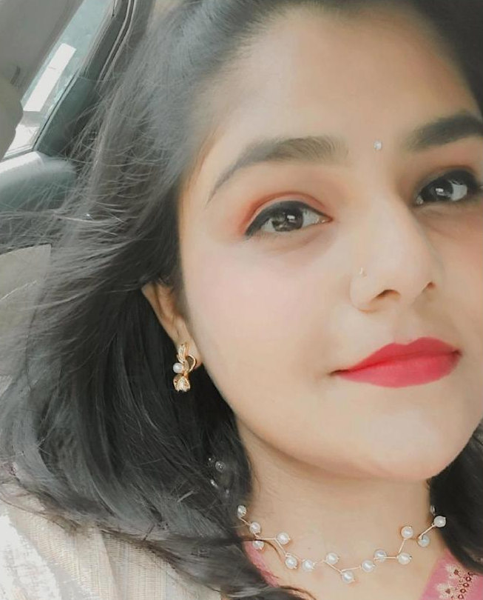
PAT ON THE BACK
A self motivated girl who works with utmost diligence and dedication.
She definitely makes it a point to do justice to the work that she has been assigned everyday. Moreover, she organizes her tasks very well.
Her sweet voice and pleasant personality makes it pleasure for our candidates to converse with her freely.
We are proud of you for the work that you do!
SWATHI SHYAM
Digital Certificate and
Gift voucher

Slide 14
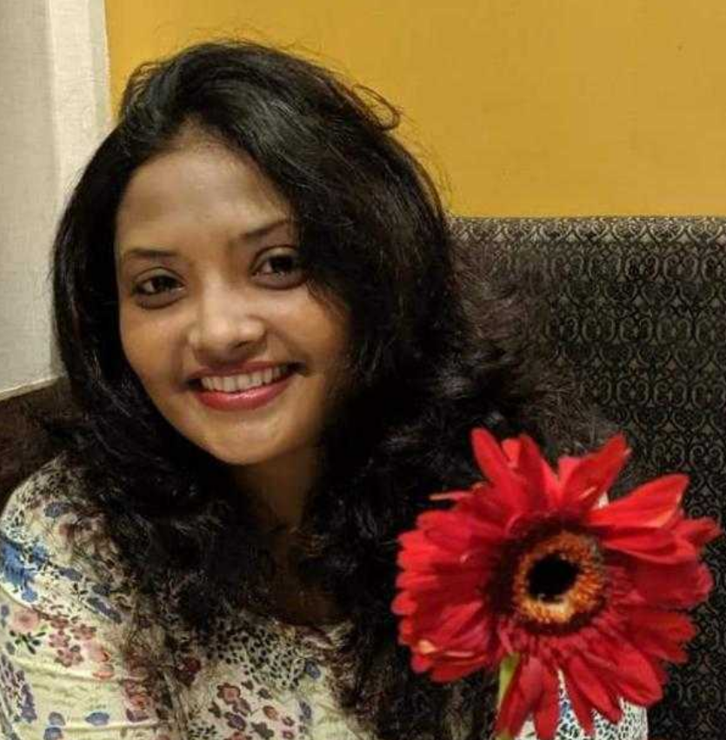
PAT ON THE BACK
She continues to maintain a high level of quality in her work. She is a consistent performer and ensures that every task undertaken is completed to perfection.
A dedicated and committed team player, her focus on excellence is noteworthy.
Looking forward to seeing you achieve a lot more Vidhi !
She definitely deserve a pat on the back!
VIDHI THAPAR
Digital Certificate and
Gift voucher

Slide 15
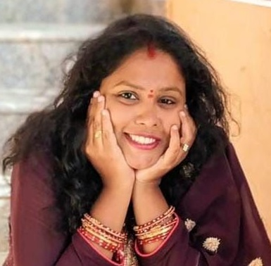
PAT ON THE BACK
A counsellor who proved her worth in a short span of time – Priyanka is a blessing and an asset to the team and her SME.
She handles her candidates with smoothness and grace. Her warm and friendly tone makes it easy for her to build a rapport with all of them.
She is pro-active by nature and takes ownership for her work. Continue to make us proud Priyanka!
She definitely deserve a pat on the back!
PRIYANKA KUMAR
Digital Certificate and
Gift voucher

Slide 16
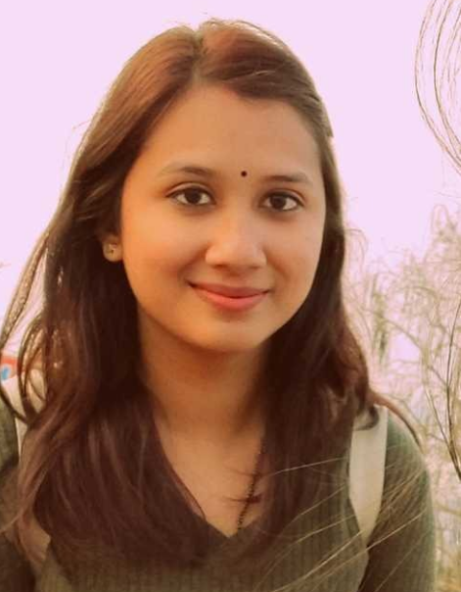
LEADERSHIP CHOICE
Tanya’s ability to work on critical client assignments from start to finish is beyond comparison.
Her single-minded focus , ability to motivate her team to get the work done and her willingness to learn from her mistakes helps her stand out from the crowd. The recent PwC assignment was a “First of its Kind” for AceNgage and Tanya helped make it a grand success story with her focus and hardwork!
Thank you completing this special assignment on time and with quality! We deeply appreciate your efforts, and this is just a small token of our gratitude !
TANYA DINGAR
Digital Certificate and
Gift voucher

Slide 17
WINNERS LIST
CHAYA RAMESH
FATHIMA JABEEN
SAMA NAQVI
PUNIT CHANDOK
ANISHA REGMI
NAVNEET KAUR
TASKEEN AHMED
PRIYA NARANG
SHRADDHA WAGHMARE
SWATHI M G
RITIKA VERMA
SWATHI SHYAM
VIDHI THAPAR
PRIYANKA KUMAR
TANYA DINGAR

Slide 18
Well Done to the winners… – …Good Luck for Mar’23

